Slide 1
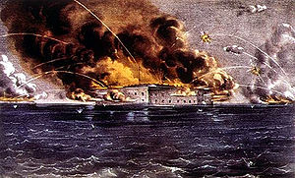
Causes of the Civil War

Slide 2
Slavery
Slavery was allowed in the United States from the time of the Constitution.

Slide 3
Many southerners believed slavery was necessary for Southern economic prosperity and must be kept.

Slide 4
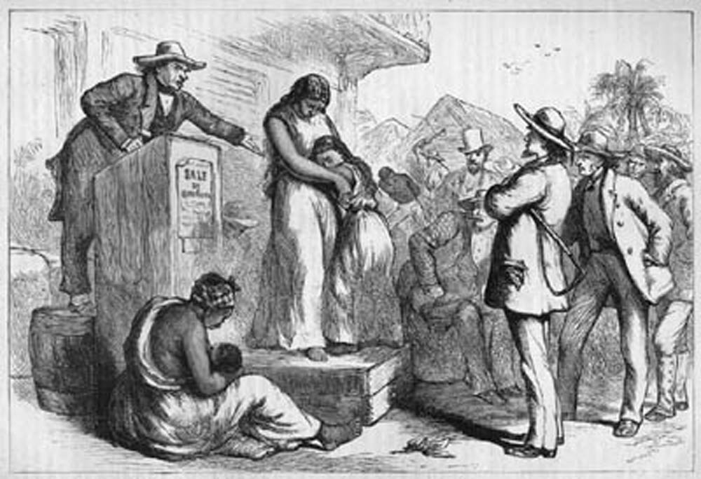
Many northerners believed slavery was immoral and should be abolished.

Slide 5
By 1860, only 3 Western countries allowed slavery: Brazil, Cuba, and the U.S.

Slide 6
Missouri Compromise (1820)
Maine = Free State
Missouri = Slave State
Kept balance between slave states & free states

Slide 7
Compromise of 1850
California = Free State
Slave trade abolished in Washington, D.C.
Utah and New Mexico Territory → up to people who live there (popular sovereignty).
Fugitive Slave Law: Free States must help catch and return escaped slaves.

Slide 8
Kansas - Nebraska Act (1854)
Establishes Popular Sovereignty over slavery in Kansas & Nebraska Territory.
Repealed Missouri Compromise
Supporters of slavery—very happy
Opponents to slavery—very angry

Slide 9
Dred Scott Ruling (1857)
Owner takes Dred Scott to a free territory; they return to slave state & owner died
Scott has abolitionist attorneys sue for freedom
It went to the Supreme Court but he LOST
The court ruled he was NOT a citizen, but rather property and therefore could not file a lawsuit
Court officially repealed the Missouri Compromise—this allowed slavery in the territories

Slide 10
Lincoln’s “House Divided” Speech (1858)
Lincoln gives speech to accept Republican Party’s nomination for President.
Says country must either: Become either all slave or all free, or
Cease to be a Union of States.

Slide 11
Lincoln’s “House Divided” Speech (1858)
“’A house divided against itself cannot stand.’ I believe this government cannot endure, permanently half slave and half free. I do not expect the Union to be dissolved—I do not expect the house to fall—but I do expect it will cease to be divided. It will become all one thing, or all the other.”

Slide 12
Lincoln-Douglas Debates (1858)
Abraham Lincoln, member of newly formed Republican Party.
Stephen A. Douglas, Democrat, responsible for Kansas-Nebraska Act
Lincoln opposed slavery and wished to limit its spread.
Douglas wanted to decide slavery using popular sovereignty & said a territory could exclude slavery.
Douglas won the Senate election but lost popularity with many Southerners.
Lincoln became very well-known and popular nationwide.

Slide 13
John Brown attacks Harpers Ferry (1859)
Brown, with 18 followers, seized federal arsenal in Harpers Ferry, Virginia.
He wanted slaves to revolt
Robert E. Lee and troops captured Brown and his followers.
Brown was tried, convicted, and hanged.

Slide 14
Lincoln elected President (1860)
Lincoln wins Presidency without a majority of popular votes.
Declares not to end slavery in south, but end expansion in territories.
Southerners see him as a threat to their lifestyle.

Slide 15
Southern States Secede from Union.
Starting with South Carolina, states secede from the Union. (December 1860)
These states form the Confederacy - a new government of Southern States.
Mississippi, Florida, Alabama, Georgia, Louisiana, & Texas (1861)
*secede: to withdraw

Slide 16
Jefferson Davis elected President.
Lincoln hopes for peace, but forced to arm Federal forts in the South

Slide 17
Fort Sumter Attacked (April 12, 1861)
Fort Sumter was attacked April 12, 1861
Confederate cannons fire on Fort Sumter, South Carolina.
Union forces surrender after 30 hours (and no deaths!)

Slide 18
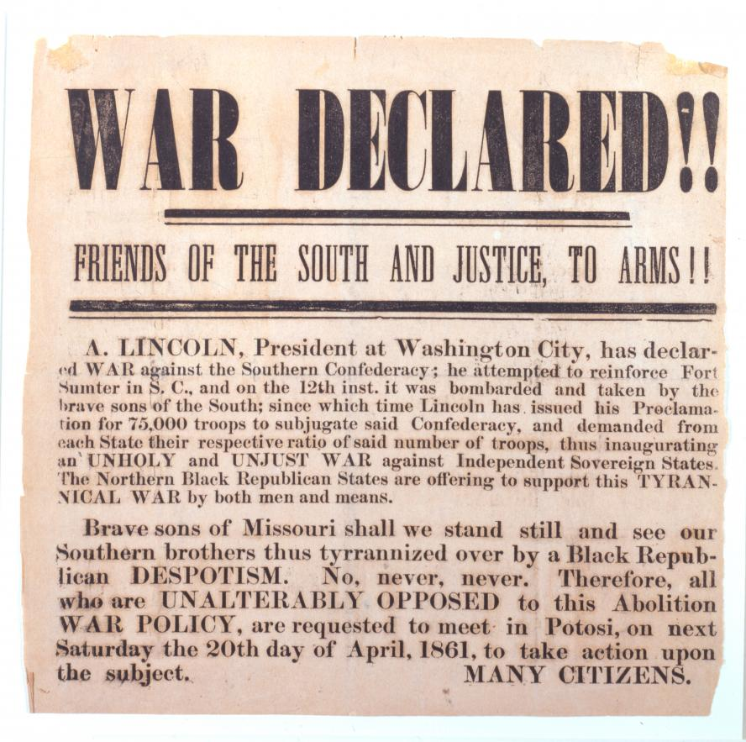
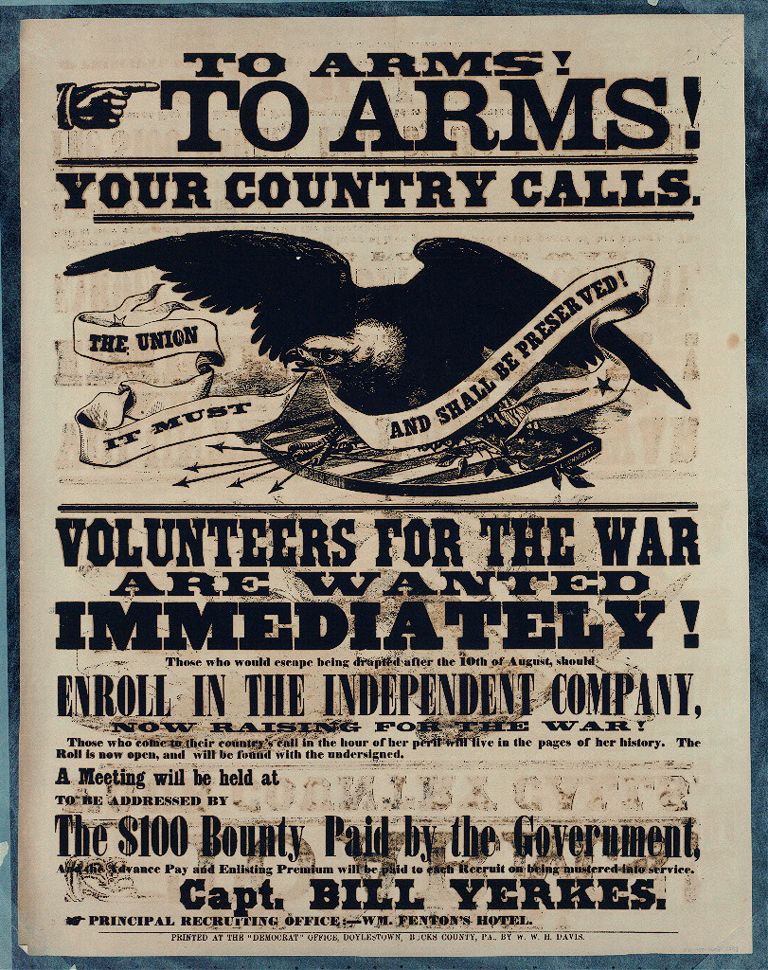
The Civil War Has Begun!

Slide 19
Name ________________ Date ___________ Per. ____
1. What is this article about?
2. What is the point of view? How can you tell (Cite evidence from the article)
3. What was the purpose of this article? What was it trying to do?

Slide 20
Name ________________
1. What is this an ad for? What was its purpose?
2. How does this ad try to persuade those who see it? (Cite evidence from the ad0
3. What is the point of view? How can you tell (Cite evidence from the ad)

