Slide 1
Unit 3 Vocabulary
What happened at the Philadelphia Convention?

Slide 2
veto

Slide 3
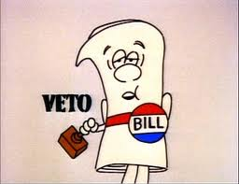
veto
To say no to a bill that has been passed in an effort to prevent it from passing
NO!

Slide 4
Great Compromise

Slide 5
Great Compromise
The agreement that stopped the conflict between the large and small states over equal and proportional representation.
New Jersey Plan-
Equal representation for all states
Virginia Plan-Representation based on population
Great Compromise
House of Representatives-Representation based on population
Senate- Equal representation for every state

Slide 6
electoral college

Slide 7
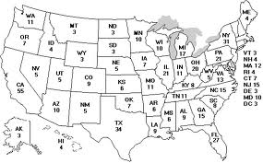
electoral college
the process for selecting the president

Slide 8
tariff

Slide 9
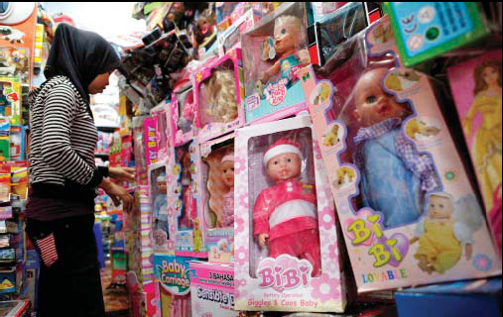
tariff
taxes on goods coming into or leaving the country

Slide 10
proportional representation

Slide 11
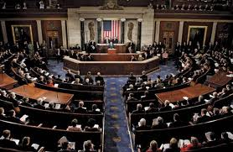
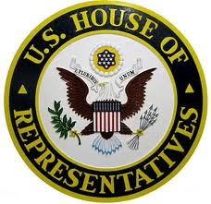
proportional representation
representation based on the population of the state

Slide 12
Philadelphia Convention

Slide 13
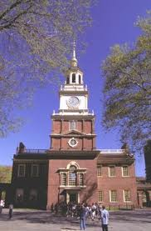
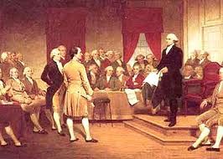
Philadelphia Convention
The meeting called to revise the Articles of Confederation.

Slide 14
equal representation

Slide 15
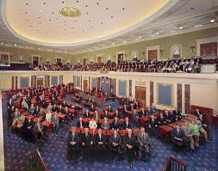
equal representation
The same number of representatives for each state.

Slide 16
enumerated powers

Slide 17
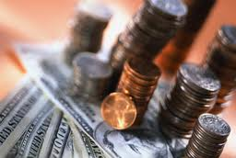
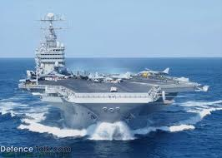
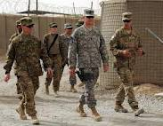
enumerated powers
specific powers granted to Congress

Slide 18
general welfare clause

Slide 19
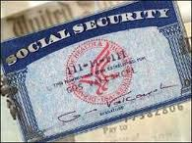
general welfare clause
one of two general statements of power for Congress
for the general welfare or the good of all people in the United States

Slide 20
necessary and proper clause

Slide 21
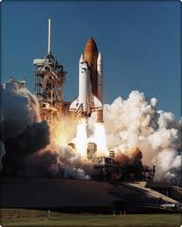
necessary and proper clause
one of the two general statements of power for Congress
all other laws that are necessary for our country

Slide 22
unconstitutional

Slide 23
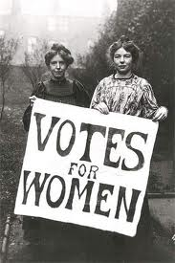
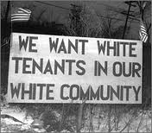
unconstitutional
not permitted under the laws of the constitution

Slide 24
impeach

Slide 25
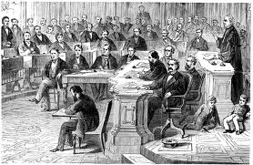
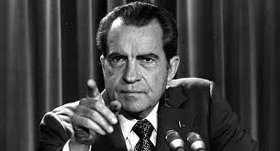
impeach
to bring a public official to trial because they are accused of a crime

